Slide 1
Modeling Primitive Skill Elements in Soar
Bryan Stearns
University of Michigan
June 2016

Slide 2
Outline
Motivation
PRIMs Theory: Primitive Skill Elements
Rule Composition
PRIMs in Soar
Learning Operator Composition
Roadmap
Conclusion

Slide 3
Primitive Skill Elements
Learning is a composition of procedural knowledge
What are the primitive building blocks of that knowledge?
Tic Tac Toe
Find a Move
Move Piece
Search
Ask
Pickup
Place
Op 1
Op 1
Op 3
Op 2
Op 3
Op 2
?
?
?
?
?
Notes:
And how may those primitive building blocks be exploited to learn more complex structures and procedures?

Slide 4
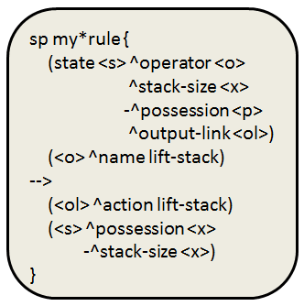
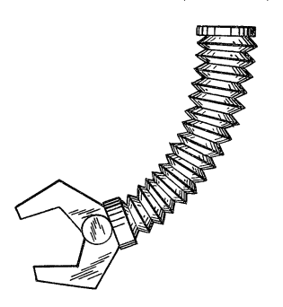
Objectives
Identify the primitive building blocks of procedural knowledge in Soar
Is there a fundamental set of operators?
How may these be composed via chunking?
Exploit primitives for construction of more complex structures and procedures
Increasing the range of knowledge manipulation
Learning internal tasks
sp my*rule {
(state <s> ^operator <o>
^stack-size <x>
-^possession <p>
^output-link <ol>)
(<o> ^name lift-stack)
-->
(<ol> ^action lift-stack)
(<s> ^possession <x>
-^stack-size <x>)
}
Notes:
graphic

Slide 5
Outline
Motivation
PRIMs Theory: Primitive Skill Elements
Rule Composition
PRIMs in Soar
Learning Operator Composition
Roadmap
Conclusion

Slide 6
Original PRIMs Model (Taatgen, 2013)
Primitive Information Processing Elements
Actransfer: An extension of ACT-R (Anderson, 2007)
Any rule may be constructed from three primitive memory operations
Compare (==, <>)
Copy
Retrieve Constant
example*pseudo*rule {
IF (Goal is “pick up stack”) AND (Stack has <X> blocks)
THEN (Set output to “lift stack”)
(Set stack to 0 blocks) (Set possession to <X> blocks)
}
“Learning any skill leads to combinations of these building blocks.”
– Niels Taatgen

Slide 7
PRIMs Need Memory Elements
Each PRIM represents fixed processing on specific memory locations, not values
Below, “compare1” is a different PRIM from “compare2”
Three PRIM types, many combinations of memory elements
Compare (2 elements)
Copy (2 elements)
Retrieve Constant (1 element)
Rules on same elements but different constants share PRIMs
compare2
retrieve
compare1
copy1
Exchanges Among Fixed Memory Locations

Slide 8
Receiving Instructions
The user gives the agent a rule in terms of PRIMs
Constants are separated from condition and action PRIMs
Each PRIM is linked in declarative memory under an instruction head
The head contains any constants
When manually evaluating instructions, constants are loaded first
pp {my*production
# Constants:
<const1> := |pick up stack|
<const2> := |lift stack|
<const3> := 0
--
# Conditions:
<goal> == <const1>
-->
# Actions:
<output> := <const2>
<stack> := <const3>
<possession> := <x>
}
My Production
const1 := “pick up stack”
const2 := “lift stack”
const3 := 0
goal == const1
output := const2
stack := const3
possession := x
Notes:
“Sequencing in diagram to show evaluation process”

Slide 9
Example: Iterating Numbers
Count Init
const1 := “order”
input1 <> nil
var1 == nil
var1 := input1
output := var1
cue1 := const1
cue2 := var1
Count Step
const1 := “order”
retrieved <> input2
Query
cue1 = “order”
cue2 = “2”
Result
retrieved = “3”
var1:= retrieved
Count Final
const1 := “done”
retrieved == input2
output := var1
status := const1
Input
input1 = “2”
input2 = “5”
Output
“2 3 4 5”

Slide 10
Example: Iterating Semantics
Category Init
const1 := “isa”
input1 <> nil
var1 == nil
var1 := input1
output := var1
cue1 := const1
cue2 := var1
Category Step
const1 := “isa”
retrieved <> input2
Query
cue1 = “isa”
cue2 = “cat”
Result
retrieved = “feline”
var1:= retrieved
Category Final
const1 := “done”
retrieved == input2
output := var1
status := const1
Input
input1 = “cat”
input2 = “animal”
Output
“cat feline mammal animal”

Slide 11
Outline
Motivation
PRIMs Theory: Primitive Skill Elements
Rule Composition
PRIMs in Soar
Learning Operator Composition
Roadmap
Conclusion

Slide 12
Soar PROPs
Define PROPs as PRIMs applied to Soar
Primitive Operator Processing Elements
Let each PROP be an operator implementing a primitive information processing element:
Condition primitives
==, <>, <=>, >, <, >=, <=, disjunction
Action primitives
add-wme, remove-wme, operator preferences, RHS functions
Restrict ID:attribute pairs to have only one value at a time for primitive operations
Compose PROPs bottom-up through a substate hierarchy into more complex operators

Slide 13
Learning Operator Composition
Build up a useful hierarchical composition of PROPs before chunking the instructions
Shared composition accelerates deliberate evaluation
Composed PROPs enable simpler user-given instructions
High level operator
Place Block
Production Operator
Op 1
Op 2
More complex operator
Learning
Transfer
PROPs

Slide 14
Learning Process
Receive instructions and represent them in working memory
(Each node depicted corresponds to an operator)
(Each level depicted corresponds to a substate)
Instructions
state 1
Instructions
state 2
const
Instructions
sp apply*prop*eq {
(state <s> ^operator <o>)
(<o> ^name prop_eq
^ID1 <id1>
^attr1 <attr1>
^ID2 <id2>
^attr2 <attr2>)
(<id1> ^<attr1> <val>)
(<id2> ^<attr2> <val>)
-->
… # Return Success
}
^1
^2
^condition
^condition
^action
^action
^action
“foo”
“bar”
“equality”
^type
^ID1
==
const
^attr1
1
^ID2
S1
^attr2
“name”

Slide 15
Learning Process
Manually evaluate and perform instructions over the lifetime of the agent
Until the full operator is chunked, deliberately follow instructions each time
Keep a count of how frequently each pair of PROPs are evaluated together
Repeatedly combine common pairs of PROPs into new symbols
The new symbol will be evaluated as its own new operator
Instructions
Instructions
A
B
X
Y
Z
C
D
E
X
Y
+1
+1
Instructions
Instructions
Instructions
A
B
XY
Z
A
B
X
Y
Z
A
B
Z
X
Y
X
Y

Slide 16
Learning Process
Once a full hierarchy is learned, the entire instruction set may be chunked to avoid future deliberate primitive instruction evaluation
New learned operators may be used instead of PROPs in higher level instructions
state 1
Instructions
Instructions
state 2
chunked apply rule
state 3
state 4
Operator 42
Operator 16
Operator 1
Operator 2
Operator 3

Slide 17
The Result
Operator 16
Operator 1
Operator 2

Slide 18
The Result
Tic Tac Toe
Find a Move
Move Piece
Search
Ask
Pickup
Place
Op 3
Op 1
Op 2
Op 3

Slide 19
Roadmap
Basic PROPs learning
Elaboration learning (from conditions)
Interactive labeling of new operators
Retroactive instruction modification
Plan

Slide 20


Conclusion
Nuggets
Can be taught procedural reasoning from scratch
Low-level may quickly be extended to high-level
Learned hierarchy can be made viewable and labelable
Coal
Not yet implemented/tested
Writing PROPs instructions requires expert knowledge
ID:attr pairs referenced by PROPs must be kept unique until those PROPs are chunked
Notes:
Takeaway: Separating task-specific constants from task-general rule knowledge allows:

Slide 21
Bibliography
Anderson, J. R. (2007). How can the human mind occur in the physical universe? doi:10.1093/acprof:oso/9780195324259.001.0001
Taatgen, N.A. (2013). The nature and transfer of cognitive skills. Psychological Review, 120(3), 439-471.

Slide 22
Modeling Primitive Skill Elements in Soar
Bryan Stearns
Questions?

Slide 23
Declarative Instructions
The agent is given primitive instructions for information processing
As instructions are deliberately evaluated the agent learns which combinations of instruction-elements are most common
Such elements are repeatedly combined to learn a hierarchical composition
Once the full composition is learned, the instructions may be chunked into a single task-specific operator
input <> nil
var1 == nil
-->
var1 := input1
output := var1
cue1 := const1
input <> nil
var1 == nil
-->
var1 := input1
output := var1
cue1 := “order”
input1 <> nil
var1 == nil
Count Init
const1 := “order”
input1 <> nil
var1 == nil
var1 := input1
output := var1
cue1 := const1
var1 := input1
output := var1
var1 := input1
output := var1
cue1 := const1

Slide 24
Learning a Rule Hierarchy
task*specific*42 {
(slot1 == “foo”)
(slot2 <> “bar”)
-->
(slot3 := slot2)
(slot2 := “foo”)
(slot1 := “bar”)
}
task*specific*43 {
(slot1 == “goo”)
(slot2 <> “car”)
-->
(slot3 := slot2)
(slot2 := “goo”)
(slot1 := “car”)
}
task*general {
(slot1 == const1)
(slot2 <> const2)
-->
(slot3 := slot2)
(slot2 := const1)
(slot1 := const2)
}
{
…
-->
(slot3 := slot2)
(slot2 := const1)
(slot1 := const2)
}
{
(slot1 == const1)
(slot2 <> const2)
-->
…
}
{
(slot1 == const1)
-->
…
}
{
(slot2 <> const2)
-->
…
}
{
…
-->
(slot3 := slot2)
}
{
…
-->
(slot2 := const1)
}
{
…
-->
(slot1 := const2)
}

Slide 25
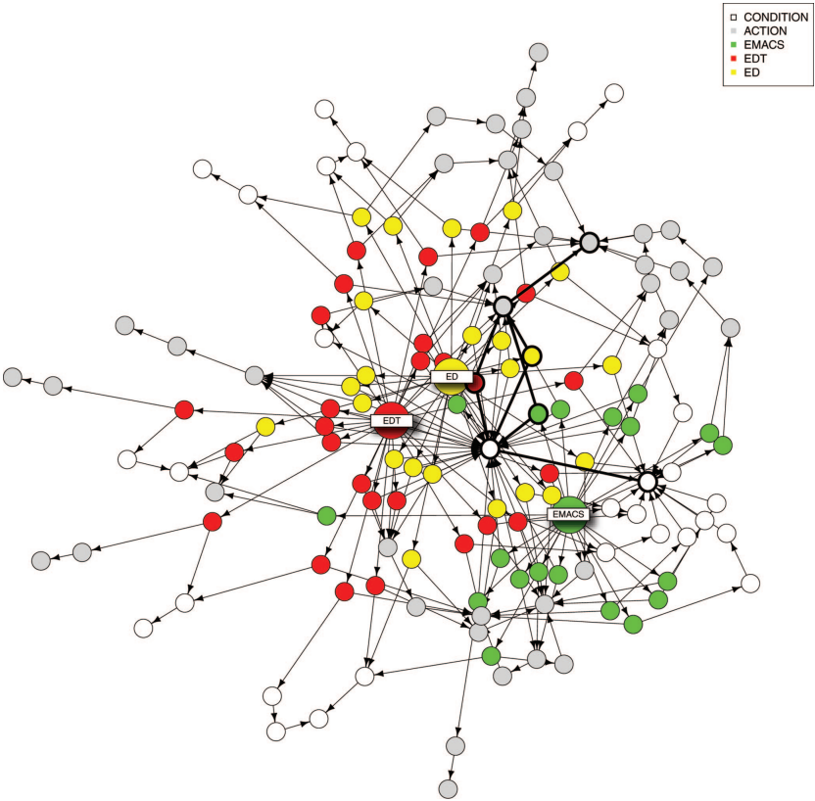
CONDITION
ACTION
EMACS
EDT
ED
Image: (Taatgen, 2013)

Slide 26
Gradually Chunking PROPs
Keep a frequency count of co-occurring PROPs
If this count passes a threshold, chunk a new operator combining the pair
Once the hierarchy is learned, the instructions may be chunked into an operator implemented by a chunked rule
Count Init

Slide 27
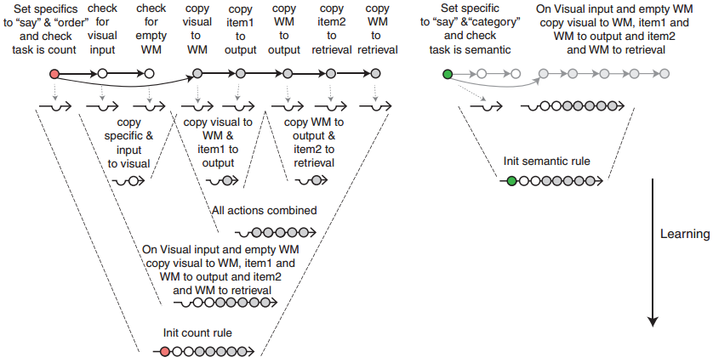
Learning Primitive Composition
Primitives are combined until a task-specific rule is learned
Combinations may be shared with new rules
Image credit: (Taatgen, 2013)
Notes:
Down vs up

Slide 28
Growing PRIMs Combinations
load constants
slot conditions
slot actions
RULE 42
task*general {
(slot1 == const1)
(slot2 <> const2)
-->
(slot3 := slot2)
(slot2 := const1)
(slot1 := const2)
}
rule42*constants {
(goal == rule42)
-->
(const1 := foo)
(const2 := bar)
}
task*specific*42 {
(goal == rule42)
(slot1 == “foo”)
(slot2 <> “bar”)
-->
(slot3 := slot2)
(slot2 := “foo”)
(slot1 := “bar”)
}

Slide 29
Growing PRIMs Combinations
load constants
slot conditions
slot actions
RULE 43
task*general {
(slot1 == const1)
(slot2 <> const2)
-->
(slot3 := slot2)
(slot2 := const1)
(slot1 := const2)
}
rule43*constants {
(goal == rule43)
-->
(const1 := goo)
(const2 := car)
}
TASK-GENERAL SKILL TRANSFERRED FROM RULE42
task*specific*43 {
(goal == rule43)
(slot1 == “goo”)
(slot2 <> “car”)
-->
(slot3 := slot2)
(slot2 := “goo”)
(slot1 := “car”)
}

Slide 30
Using Variables
Soar does not use fixed memory slots
There are infinitely many possible attributes
WMEs are referenced via relations
Conditions and actions can’t be broken apart without losing relation constraints
S1 | foo | 42
S1 | bar | 42
S1 | bar | 43
If (S1 ^bar <v2>) <> (S1 ^foo <v1>)
If (S1 ^bar <v2>) <> (S1 ^foo <v1>)
Remove S1 ^bar <v2>

Slide 31
Variable Solution
Restrict WMEs to behave like unique slots
Let an ID:attribute pair represent a unique slot
It may only have one value at a time (at first)
As composite operators/rules are built, this restriction may be weaned away
S1 | foo | 42
S1 | bar1 | 42
S1 | bar2 | 43
If (S1 ^bar2 <v2>) <> (S1 ^foo <v1>)
Remove S1 ^bar2 <v2>

